Slide 1





BLOCKCHAIN – BASED AUTONOMOUS VOTING SYSTEM USING ETHEREUM
Presented By Batch-4 :
( 218T1A4251 - NAVYA SRI .V
218T1A4209 - ANU CHANDANA .CH
218T1A4229 - MOHAMMAD FAHAMEED SAMEER
218T1A4210 - TEJO VARDHAN VARMA .CH
218T1A4223 - RAJESH KUMAR .M )
GUIDE : Mrs. Mareswaramma

Slide 2
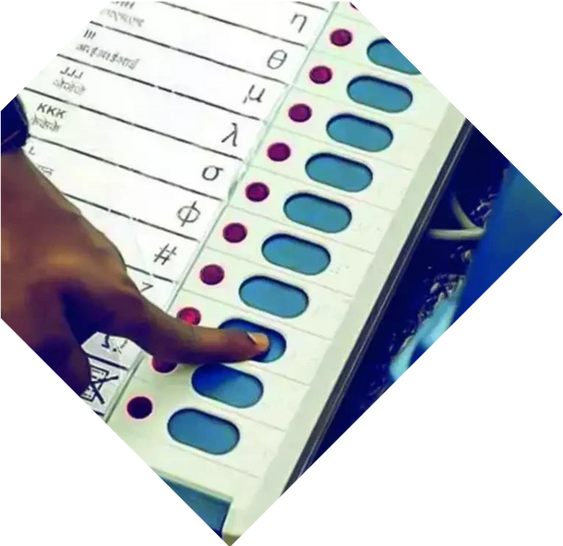


Abstract
The traditional voting system faces challenges like fraud, security breaches, lack of transparency, and inefficiency.
SecureSphere, a decentralized voting system using Ethereum blockchain, aims to provide a tamper-proof, transparent, and secure voting mechanism.
By leveraging smart contracts, this system ensures that votes are immutable, verifiable, and resistant to manipulation. The decentralized nature eliminates the need for intermediaries, enhancing trust and efficiency in electoral processes.

Slide 3

Justification :
Current Voting System Challenges
Current voting systems often suffer from security vulnerabilities, centralized control, and low voter trust. Issues such as voter fraud, multiple voting, and vote tampering impact the credibility of elections.
Blockchain-based voting ensures decentralization, transparency, and security, making it a promising alternative.This justifies its existence by addressing these concerns, providing a system where each vote is securely recorded and verifiable without compromising voter privacy.

Slide 4


Problem Statement :
Conventional voting systems are prone to fraud, inefficiency, and central authority control. Paper-based and electronic voting machines (EVMs) are susceptible to tampering, hacking, and logistical challenges.
There is a need for a secure, transparent, and decentralized voting system that eliminates fraud, ensures integrity, and provides instant and verifiable results.

Slide 5



SCOPE :
Implementing Ethereum-based smart contracts for secure voting.
Ensuring voter authentication and privacy using cryptographic techniques.
Developing a user-friendly interface for voters and election officials.
Supporting tamper-proof and verifiable election results with real-time updates.
Allowing remote voting, increasing accessibility for voters.

Slide 6



Objectives :
Security – Prevent vote tampering and unauthorized access.
Transparency – Allow public verification of election results while maintaining voter anonymity.
Decentralization – Eliminate reliance on a central authority.
Efficiency – Reduce manual vote counting and speed up election result declaration.
Accessibility – Enable remote and secure voting for all eligible users

Slide 7

Benefits of Decentralized Voting
Decentralization through blockchain can mitigate risks associated with centralized voting systems. It promotes transparancy, reduces the potential for fraud, and empowers voters by giving them control over their own voting data.

Slide 8



How Blockchain Ensures Security
Blockchain'scryptographic features ensure that votes are securely recorded and cannot be altered. Each transaction is linked to the previous one, creating a chain that is virtually impossible to tamper with, thus safeguarding electoral integrity.

Slide 9
Basic Concepts :
Blockchain – A distributed ledger that records transactions securely and transparently.
Ethereum – A decentralized platform that enables smart contract execution.
Smart Contracts – Self-executing contracts that automate and enforce voting rules.
Cryptographic Hashing – Ensures data integrity and security in the voting process.
Decentralized Identity – Ensures voter authentication while protecting privacy.

Slide 10
A view on
Blockchain Technology
Block chain is a decentralized ledger that records transactions across many computers. This ensures that he secure data cannot be altered retroactively, providing a and transparency method for recording votes in electoral systems.
Ethereum Technology[ETH]
Ethereum is a decentralized platform that allows developers to create applications and smart contracts on its blockchain. It uses Ether (ETH) as its cryptocurrency to pay for transactions and computational services.

Slide 11

Case Studies of Blockchain Voting
Several jurisdictions have successfully implemented blockchain voting in pilot projects. These case studies demonstrate increased turnout, voter improved trust in electrol the process and a effective voting experience for participants.

Slide 12

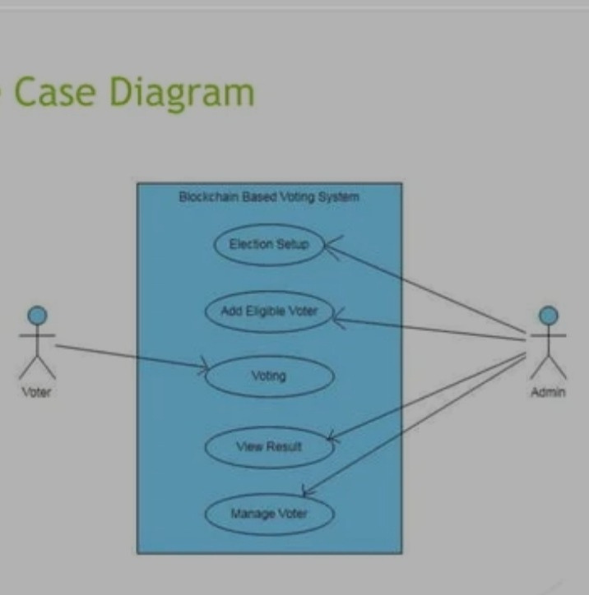
Design/structure :

Slide 13
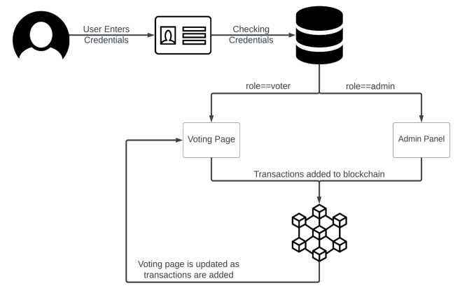
Design/structure :

Slide 14

Technologies used
Node.js (version – 18.14.0)
Truffle
Ganache CLI
Metamask
solidity
web3.js
HTML/CSS/JS/npm
Python (version – 3.9)
Features
Implements JWT for secure voter authentication and authorization.
Utilizes Ethereum blockchain for tamper-proof and transparent voting records.Removes the need for Intermediaries, ensuring a trustless voting process. Admin panel to manage candidates, set voting dates, and monitor UI

Slide 15

Addressing Privacy Concerns / Challenges
While blockchain provides transparency, it also raises concerns about voter privacy. Solutions include anonymizing voter identities while ensuring that votes are still verifiable, striking a balance between transparency and confidentiality.

Slide 16
Future of Voting Systems
The integrationof blockchain technology in voting systems represents a significant shift towards more secure, efficient, and trustworthy elections. As technology evolves, it is crucial to adapt and innovate to meet the needs of modern democracies.

Slide 17
Literature Survey :
A. Sharma, S. Gautam, S. Goel and A. Kumar, "Blockchain-Based E-Voting System," 2018 Second International Conference on Inventive Communication and Computational Technologies (ICICCT), Coimbatore, India, 2018, pp. 1312-1315, doi: 10.1109/ICICCT.2018.8473251. (Click Here)
A. S. Alketbi, Q. Nasir and M. A. Talib, "Blockchain for Government Services — Use Cases, Security Benefits and Challenges," 2018 15th Learning and Technology Conference (L&T), Jeddah, Saudi Arabia, 2018, pp. 112-119, doi: 10.1109/LT.2018.8368490. (Click Here)
M. A. Rahman, M. S. Hossain, N. A. Bhuiyan and M. S. Islam, "A Blockchain-Based Decentralized E-Voting Framework for a Large-Scale Election," 2019 IEEE International Conference on Smart Computing (SMARTCOMP), Washington, DC, USA, 2019, pp. 1-6, doi: 10.1109/SMARTCOMP.2019.00027. (Click Here)
S. Noizat, "Blockchain Electronic Vote," 2015 IEEE International Conference on Digital Society and e-Governments (ICDS), Lisbon, Portugal, 2015, pp. 86-92, doi: 10.1109/ICDS.2015.19. (Click Here)
A. Kiayias, O. Panagiotakos and B. Zhang, "Democracy 2.0: A Secure E-Voting System Based on Blockchain Technology," 2015 IEEE Symposium on Security and Privacy Workshops, San Jose, CA, USA, 2015, pp. 44-52, doi: 10.1109/SPW.2015.33.
(Click Here)

Slide 18


















Presented By Batch-4 :
218T1A4251 - VANGALA NAVYA SRI
218T1A4209 - CHILUKURI ANU CHANDANA
218T1A4229 - MOHAMMAD FAHAMEED SAMEER
218T1A4210 - CHITRAJU TEJO VARDHAN VARMA
218T1A4223 - MADDALA RAJESH KUMAR
GUIDE : Mrs.P.Mareswaramma

